Slide 1
Best First Search
A* Algorithm

Slide 2
Notion of Heuristics
Heuristics use domain specific knowledge to estimate the quality or potential of partial solutions
Examples
  Manhattan distance heuristic for 8 puzzle

Slide 3
Calculating Cost
f(n) = g(n) + h(n)
g(n) – Actual cost of traversing from initial state to state n
h(n) – Estimated cost of reaching to the goal from state n

Slide 4
A* Algorithm
Given: [S, s, O, G, h] where
  S is the (implicitly specified) set of states
  s is the start state
  O is the set of state transition operators each having some cost
  G is the set of goal states
  h( ) is a heuristic function estimating the distance to a goal
To find:
  Min. cost of sequence of transactions to the goal state

Slide 5
A* Algorithm
Initialize: Set OPEN = {s},
CLOSE = { }, Set f(s) = h(s), g(s)=0
Fail:
  If OPEN ={ }, Terminate with Failure
Select: Select the minimum cost state, n, form OPEN and Save n in CLOSE
Terminate:
  If n ∈ G, terminate with SUCCESS

Slide 6
A* Algorithm
Expand:
  Generate the successors of n using O. For each successor, m, insert m in OPEN only if m ∉ [OPEN ∪ CLOSE]
  set g(m) = g(n) + C(n,m)
  set f(m) = g(m) + h(m)
  insert m in OPEN
  if m ∈ [OPEN ∪ CLOSE]
  Set g(m) = min{ g(m), g(n)+C(m,n)}
  set f(m) = g(m) + h(m)
  If f(m) has decreased and m ∈ CLOSE move it to OPEN
Loop: Goto step 2

Slide 7
12
2
10
1
16
2
15
1
2
3
4
3
1
1
3
12
5
7
1
11
5
15
5
6
7
8
1
4
10
15
12
8
4
3
1
1
9
10
11
12
0

Slide 8
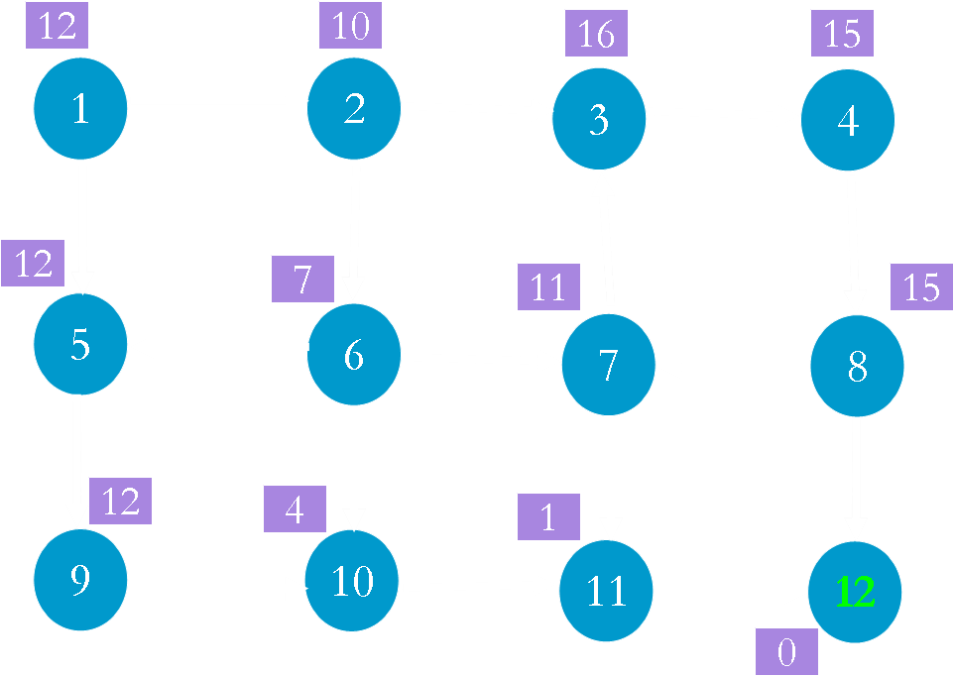
OPEN
1(12)
Node g()
1 0
CLOSE

Slide 9
OPEN
Node g()
1 0
CLOSE
1(12)

Slide 10
OPEN
2(12) 5(13)
Node g()
1 0
2 2
5 1
CLOSE
1(12)

Slide 11
OPEN
5(13)
Node g(n)
1 0
2 2
5 1
CLOSE
1(12) 2(12)

Slide 12
OPEN
5(13) 3(19) 6(12)
Node g()
1 0
2 2
5 1
3 3
6 5
CLOSE
1(12) 2(12)

Slide 13
OPEN
5(13) 3(19)
Node g()
1 0
2 2
5 1
3 3
6 5
CLOSE
1(12) 2(12) 6(12)

Slide 14
OPEN
10(13) 3(19) 5 (13)
7(17)
Node g()
1 0
2 2
5 1
3 3
6 5
7 6
10 9
CLOSE
1(12) 2(12) 6(12)

Slide 15
OPEN
10(13) 3(19) 7(17)
Node g()
1 0
2 2
5 1
3 3
6 5
7 6
10 9
CLOSE
1(12) 2(12) 6(12) 5(13)

Slide 16
OPEN
3(19) 10(13) 7(17)
9(14)
Node g()
1 0
2 2
5 1
3 3
6 5
7 6
10 9
9 2
CLOSE
1(12) 2(12) 6(12) 5 (13)

Slide 17
OPEN
3(19) 7(17) 9(14)
Node g()
1 0
2 2
5 1
3 3
6 5
7 6
10 9
9 2
CLOSE
1(12) 2(12) 6(12) 5 (13)
10(13)

Slide 18
OPEN
3(19) 7(17) 9(14)
11(13)
Node g()
1 0
2 2
5 1
3 3
6 5
7 6
10 9
9 2
11 12
CLOSE
1(12) 2(12) 6(12) 5 (13)
10(13)

Slide 19
OPEN
3(19) 7(17) 9(14)
Node g()
1 0
2 2
5 1
3 3
6 5
7 6
10 9
9 2
11 12
CLOSE
1(12) 2(12) 6(12) 5 (13)
10(13) 11(13)

Slide 20
OPEN
3(19) 7(17) 9 (14)
12 (13)
Node g()
1 0
2 2
5 1
3 3
6 5
7 6
10 9
9 2
11 12
12 13
CLOSE
1(12) 2(12) 6(12) 5 (13)
10(13) 11(13)

Slide 21
OPEN
3(19) 7(17) 9 (14)
Node g()
1 0
2 2
5 1
3 3
6 5
7 6
10 9
9 2
11 12
12 13
CLOSE
1(12) 2(12) 6(12) 5 (13)
10(13) 11(13) 12 (13)

Slide 22
Comparing with OR Graph Search
Instead of 11 nodes (OR) we expanded only 7 nodes in A*
Inference: Nodes which looked promising initially were found to be not so good later on and were ignored/left off

Slide 23
5
1
3
1
4
2
3
23
4
3
4
2
Suppose h() under
estimates
1
3
5
20
6
0

Slide 24
5
1
OPEN
1(5)
3
1
4
2
3
23
4
3
4
2
1
3
5
20
CLOSE
0
6

Slide 25
5
1
OPEN
3
1
4
2
3
23
4
3
4
2
1
3
5
20
CLOSE
1(5)
0
6

Slide 26
5
1
OPEN
2(7) 3(24)
3
1
4
2
3
23
4
3
4
2
1
3
5
20
CLOSE
1(5)
0
6

Slide 27
5
1
OPEN
3(24)
3
1
4
2
3
23
4
3
4
2
1
3
5
20
CLOSE
1(5) 2(7)
0
6

Slide 28
5
1
OPEN
3(24) 4(9)
3
1
4
2
3
23
4
3
4
2
1
3
5
20
CLOSE
1(5) 2(7)
0
6

Slide 29
5
1
OPEN
3(24)
3
1
4
2
3
23
4
3
4
2
1
3
5
20
CLOSE
1(5) 2(7) 4(9)
0
6

Slide 30
5
1
OPEN
3(24) 5(11)
3
1
4
2
3
23
4
3
4
2
1
3
5
20
CLOSE
1(5) 2(7) 4(9)
0
6

Slide 31
5
1
OPEN
3(24)
3
1
4
2
3
23
4
3
4
2
1
3
5
20
CLOSE
1(5) 2(7) 4(9) 5(11)
0
6

Slide 32
5
1
3
1
OPEN
3(24) 6(28)
4
2
3
23
4
3
4
2
1
3
5
20
6
CLOSE
1(5) 2(7) 4(9) 5(11)
0

Slide 33
5
1
3
1
OPEN
6(28)
4
2
3
23
4
3
4
2
1
3
5
20
CLOSE
1(5) 2(7) 4(9) 5(11)
3(24)
0
6

Slide 34
5
OPEN
6(28) 4(6)
1
3
1
4
2
3
23
4
3
4
2
1
3
5
20
CLOSE
1(5) 2(7) 4(9) 5(11)
3(24)
0
6

Slide 35
5
OPEN
6(28)
1
3
1
4
2
3
23
4
3
4
2
1
3
5
20
CLOSE
1(5) 2(7) 4(9) 5(11)
3(24) 4(6)
0
6

Slide 36
5
OPEN
6(28) 5(8)
1
3
1
4
2
3
23
4
3
4
2
1
3
5
CLOSE
1(5) 2(7) 4(9) 5(11)
3(24) 4(6)
20
0
6

Slide 37
5
1
3
1
4
2
3
23
OPEN
6(28)
4
3
4
2
1
3
5
CLOSE
1(5) 2(7) 4(9) 5(11)
3(24) 4(6) 5(8)
20
0
6

Slide 38
5
1
3
1
4
2
3
23
OPEN
6(28) 6(25)
4
3
4
2
1
3
5
CLOSE
1(5) 2(7) 4(9) 5(11)
3(24) 4(6) 5(8)
20
0
6

Slide 39
5
1
3
1
4
2
3
23
OPEN
4
3
4
2
1
3
5
CLOSE
1(5) 2(7) 4(9) 5(11)
3(24) 4(6) 5(8) 6(25)
20
0
6

Slide 40
Results
A heuristic is called admissible if it always under estimates, that is, we always have h(n) ≤ f*(n), where f*(n) denotes the minimum distance to a goal state from state n
For finite state spaces, A* always terminates
Algorithm A* is admissible, that is, if there is a path from start state to a goal state, A* terminates by finding an optimal path

